Slide 1
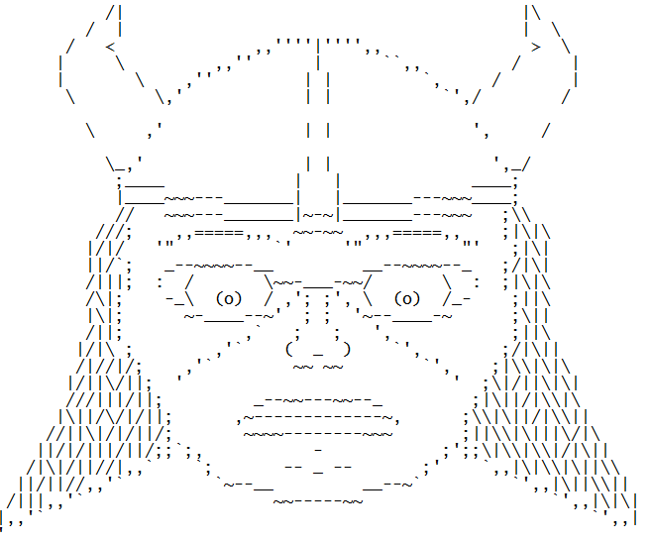
VikingFS (File System)

Slide 2
The Team
François Genois
Simon Lévesque Gobeil
Isaac Ouellet Therrien

Slide 3
What is VikingFS?
It is a version control system for Taxprep files.
Used to backup and track all modifications made to a file.

Slide 4
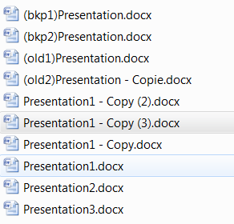
What does that mean…
You no longer have to manage manual backup.

Slide 5
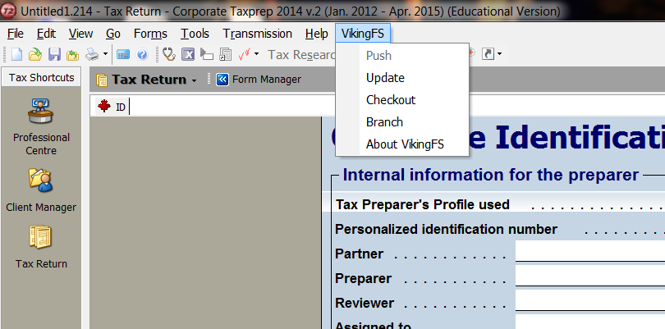

VikininFS is integrated in Taxprep as an Add-In.

